Slide 1
WILL AI BE
COMPLETELY FREE?
(SOON)
Local AI, without the technical jargon
Notes:
Today I want to ask a simple question: will AI eventually become free? My short answer is almost. The price of using AI may become much less visible, especially when it runs on a device we already own. But the computer, electricity, updates, and responsibility do not disappear. I will explain that idea without going too far into the technical details.

Slide 2


You have probably used AI already
02
ChatGPT
Claude
Notes:
I am sure most people in this room have used ChatGPT or Claude before. We open a website or an app, type a question, and get an answer within seconds. That experience feels almost magical because we do not see what happens behind the screen. The important point for this talk is that the answer is being produced on computers somewhere, and someone has to pay for those computers.
Sources and image credits:
- ChatGPT logo image — https://commons.wikimedia.org/wiki/File:ChatGPT-Logo.svg
- OpenAI design guidelines — https://openai.com/brand/
- Claude icon — https://github.com/simple-icons/simple-icons/blob/develop/icons/claude.svg

Slide 3
Where the answer happens
03
YOU
THE INTERNET
A DATA CENTER
Someone pays for the answer.
Notes:
With most popular AI services, your question travels through the internet to a data center. Powerful computers there produce the answer and send it back. This is convenient because the company handles the difficult parts for us. But it also means the company pays for every request, and our information leaves our device. That is the system local AI is trying to change.

Slide 4
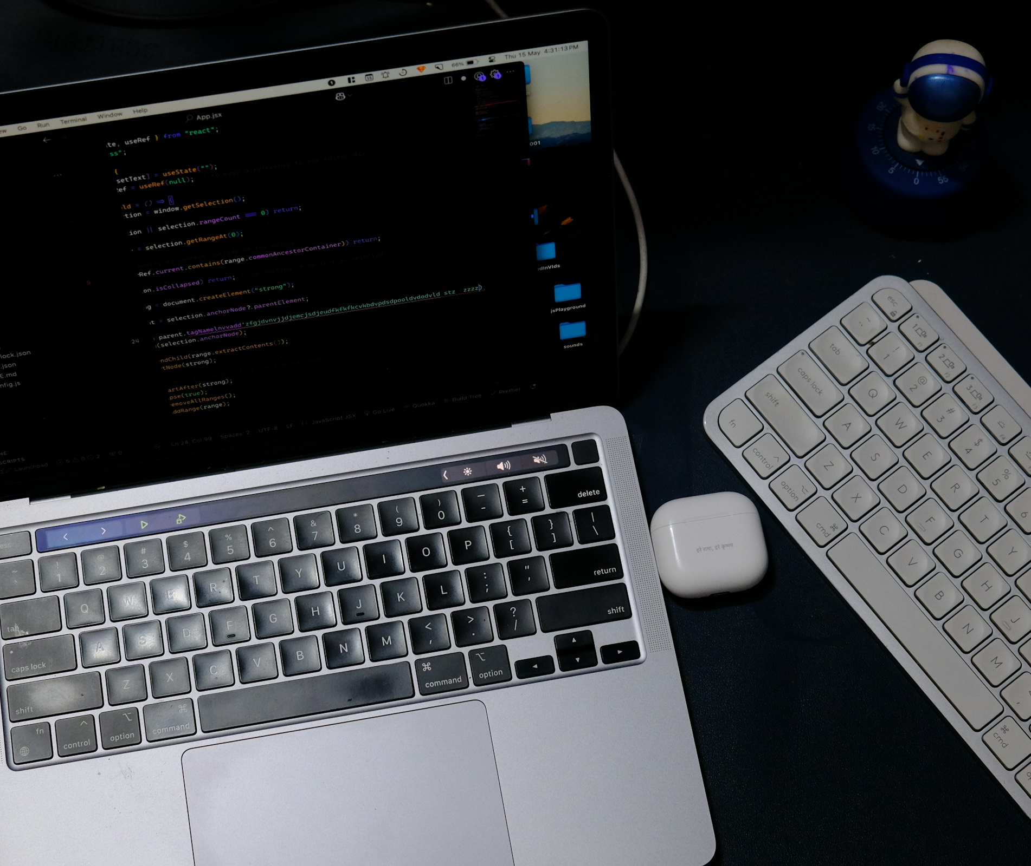
What if the AI stayed on your laptop?
04
AI can run on a device you control.
No Wi-Fi required.
Notes:
A local AI model moves the main work from a company data center onto a laptop, desktop, phone, or private computer that you control. It does not have to be permanently disconnected from the internet. The simple difference is where the answer is produced. If the model runs on your own device, it can work offline and sensitive files do not automatically need to be sent to an outside company.
Sources and image credits:
- Stock photo: Rahul Mishra, Unsplash — https://unsplash.com/photos/laptop-and-keyboard-on-a-dark-desk-BA2ELfOTqJ4

Slide 5



You can try this today
05
Qwen + Kimi
Ollama
Downloadable models
Runs them on your laptop
Notes:
Local AI is not a distant idea. Families such as Qwen and Kimi provide models that people can download. Software such as Ollama makes some of those models much easier to run. You do not need to memorize these names. They simply show that an alternative to renting every answer from a large provider already exists, although the largest models still need expensive hardware.
Sources and image credits:
- Qwen official repository — https://github.com/QwenLM/Qwen
- Kimi official branding guide — https://github.com/MoonshotAI/Branding-Guide
- Ollama official repository and logo — https://github.com/ollama/ollama

Slide 6
Why run AI locally?
06
MORE CONTROL
without a meter
running.
It can keep working offline.
Notes:
Local AI feels more like software you own. It can keep private files on your machine and continue working when Wi-Fi drops. Once the computer is ready, repeated questions do not create a visible new charge. That matters most for ordinary work you do often, rather than the most difficult question imaginable.

Slide 7
Could it feel free?
07
ILLUSTRATIVE
Cloud costs less at first.
Local can win with heavy use.
Relative cost, not real prices
Notes:
This chart is only an illustration, not real pricing data. Cloud AI is usually cheaper and easier at the beginning because we do not need to buy special hardware. Its cost grows as we use it more. Local AI has a larger starting cost, but each extra request can become very cheap. That is why local AI may feel free to a frequent user even though the machine itself was never free.

Slide 8
Where the cost goes
08
You still pay for the computer
and the power it uses.
Notes:
The word free can hide costs. A computer had to be purchased. It consumes electricity. Models and software need updates, and someone spends time fixing problems. At home, we often ignore that work because we do it ourselves. In a company, it becomes staff time and risk. So local AI changes where the cost appears. It does not make the cost disappear.

Slide 9
Local or cloud?
09
LOCAL
CLOUD
Private, everyday work
Hard questions and current information
Most people will use both.
Notes:
Local AI is useful, but cloud services still have major advantages. A company can run much larger systems, connect them to current information, and serve many users at once. Local AI works best for private, repeated, or offline tasks. The cloud works best when we need the strongest model or the newest information. There is no single winner for every situation.

Slide 10
Privacy is not automatic
10
*
A local app can still
send data online.
Check plugins and backups.
Notes:
Local AI can protect privacy, but the word local is not a guarantee. A connected plugin may send information to another service. A cloud backup may copy files off the device. Saved logs can keep sensitive prompts. The safer question is not simply, ‘Is the model local?’ It is, ‘Where does the information travel from beginning to end?’

Slide 11
The downside
11
Cheap AI can make
spam and scams
cheaper too.
More access means more responsibility.
Notes:
Cheaper access cuts both ways. The same tools that help ordinary people can also make spam and scams cheaper. At work, people may run unapproved models on private information. Wider use can increase total power demand as well. The risk does not disappear when AI leaves a big company and moves onto personal devices.

Slide 12
One assistant, two places
12
ON YOUR DEVICE
IN THE CLOUD
ONE
ASSISTANT
You may not notice the switch.
Notes:
The most likely future is a mix. Your device will handle routine private work. The cloud will step in when a problem needs a bigger model or current information. To the user, it may still look like one assistant. What matters is being able to see when a request leaves the device.

Slide 13
SO, WILL AI BE
COMPLETELY FREE?
ALMOST.
The price per question can disappear.
The real costs stay.
13
Notes:
So, will AI be completely free? It may feel almost free for everyday use. If the model runs on a computer we already own, the visible price after each question can disappear. But somebody still pays for the hardware, electricity, updates, security, and mistakes. The real change is not that intelligence costs nothing. The change is that more people may own the tool and decide where their information goes.

